Slide 1
System Integration
Microsoft Dynamics 365 Business Central

Slide 2
Agenda
Today´s team
Who is AlfaPeople
What is an Integration, and how does it help my business?
Integration strategies and embracing standardization
Microsoft Dynamics 365 Business Central capabilities
Real-life example
Key takeaways

Slide 3

Troels Thisted
Delivery Manager
E-mail: tth@alfapeople.com
Phone: +45 50753041

Slide 4

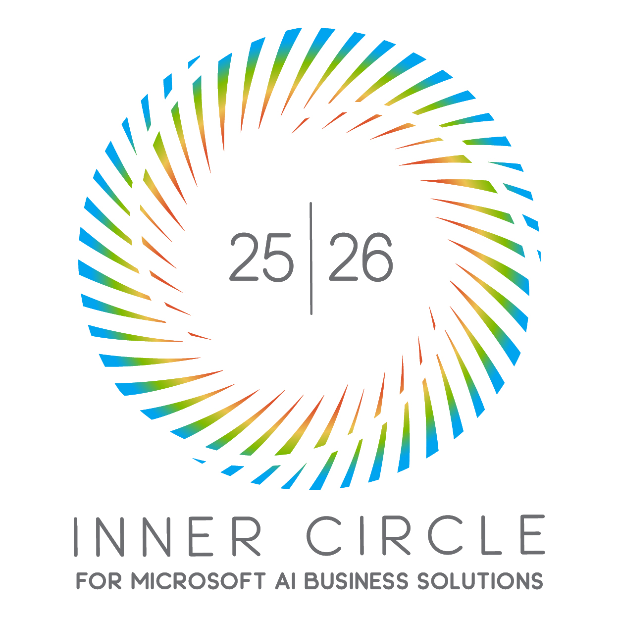
Who is AlfaPeople?
- leading Microsoft Dynamics 365 partner
Present in 14+ countries
650+ employees globally
450+ Microsoft-certified consultants
Offshore team in India and LATAM
500+ active customers globally
Europe: Denmark, Germany, Spain, Switzerland
North America: USA, Canada
Asia: China
Middle East: Saudi Arabia, United Arab Emirates
Latam: Brazil, Chile, Costa Rica, Colombia, Ecuador, Guatemala, Mexico, Paraguay, Peru, Uruguay
Top 1% of Worldwide Partners.
Part of the Inner Circle for the last 16 years and received several awards.

Slide 5
What is an Integration, and how does it help your Business?

Slide 6
What is an integration?
In the context of ERP systems, integration refers to connecting different software applications so that they can share data and work together.
For example:
Your ERP system (Microsoft Dynamics 365 Business Central) manages finance, manufacturing, and operations.
Your e-commerce system (webshops like Shopify) manages your B2B and B2C orders.
An integration between ERP and e-commerce allows orders to sync automatically:
The customer buys a product on your webshop.
The order is automatically sent to Business Central.
Business Central creates a sales order for processing.

Slide 7


What do we achieve with integrations?
Without integration
With integration
A customer places an order on your webshop.
Staff manually re-enters the order into Business Central (BC).
Inventory in the webhop is not in sync with BC stock levels.
Finance must reconcile the webshop payments manually. → Slower processes, more errors, poor visibility
Order Sync:
Customer buys a product on the webshop.
The order is automatically sent to Business Central.
Inventory Updates:
BC tracks real-time stock across warehouses.
Inventory updates are pushed to the webshop automatically, and customers only see available stock.
Payment & Finance:
The webshop payment data flows into BC and marks orders as paid.
Shipping & Fulfillment:
BC passes order details to warehouse/shipping systems.
When fulfilled, tracking info is sent back to the webshop, updating the customer automatically.

Slide 8
Different integration methods and their pros and cons

Slide 9
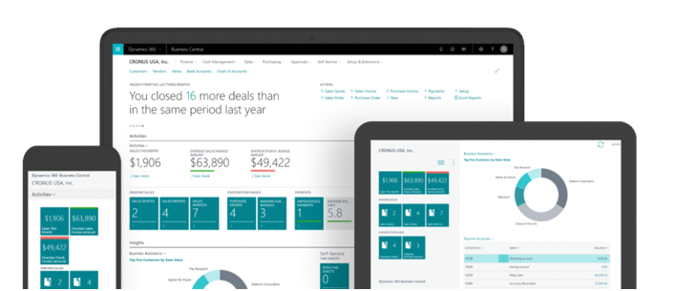
Typical systems that offers integrations
ERP: Enterprise Resource Management
CRM: Customer Relationship Management
Webshops & E-Commerce: Shopify, Magento, etc.
PIM: Product Information Management
WMS: Warehouse Management Systems
BI: Business Intelligence
CPQ: Configure Price Quote
PM Tools: Project Management Systems
and more…

Slide 10
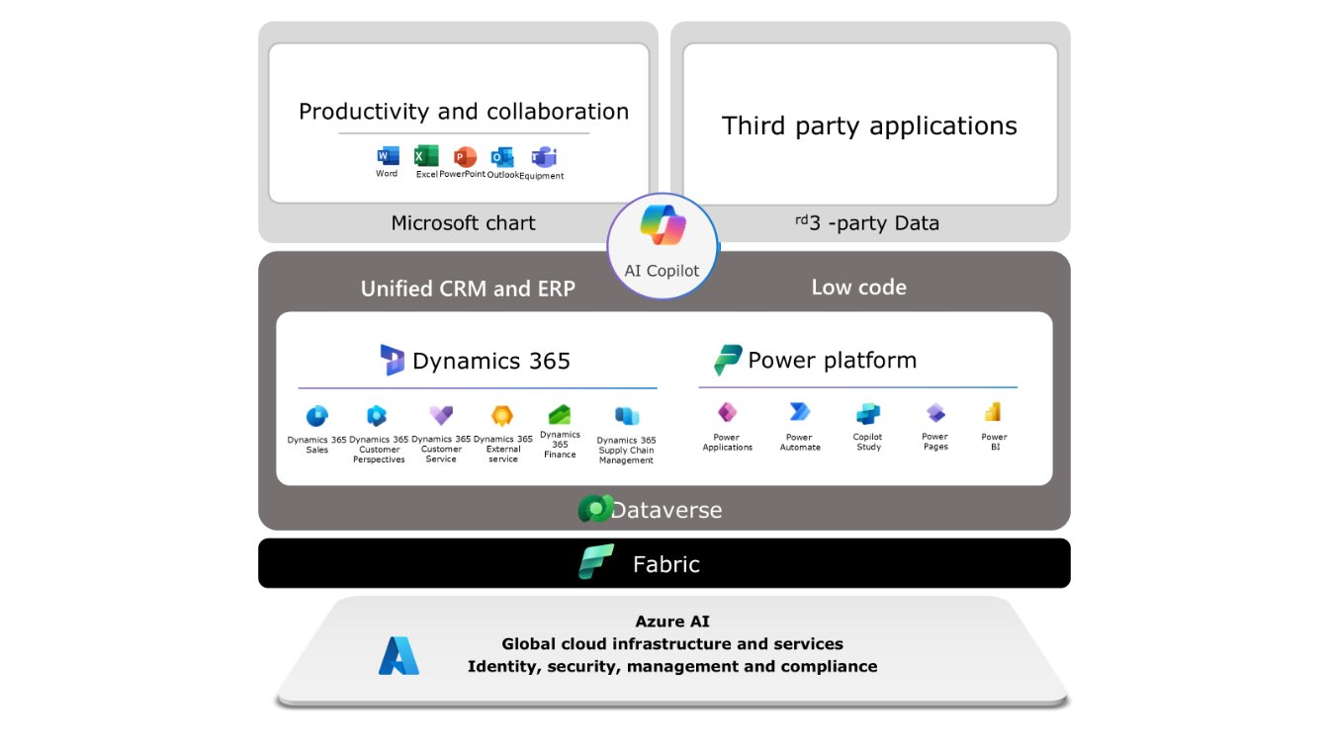
Method: Point-to-point integration
Direct connection between ERP and another system.
Example: The CRM sends sales orders directly into the ERP.
Simple, fast setup.
Becomes hard to manage when many systems are connected.

Slide 11


Method: File-based integration
Data exchanged through files (CSV, XML, JSON, etc.), often via FTP/SFTP.
Example: Nightly batch upload of purchase orders from the e-commerce site into FTP and from there to the ERP.
Easy for legacy systems.
Not real-time; prone to delays and errors, old approach, hard for newer systems to integrate.
SFTP

Slide 12


Method: API-Based integration
APIs (Application Programming Interfaces) exposed by ERP or third-party systems.
REST or SOAP APIs are common, well-known and easy to integrate to by most systems.
Example: ERP provides an API to pull inventory levels, which your e-commerce site queries live.
API
Real-time, reliable, scalable.
Requires ERP to have robust APIs.
ERP
webshop

Slide 13


Method: EDI (Electronic Data Interchange)
Standardized format for exchanging business documents (invoices, POs, shipping notices).
Widely used in supply chain, logistics, retail.
Industry standard for B2B and governmental invoicing.
Less flexible, can be costly to maintain and implement.
Purchase order
$
Buyer´s internal system
Supplier´s internal system
Invoice

Slide 14
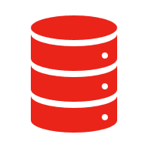

Custom integrations
Built specifically for your business needs using custom scripts, data from multiple tables, connectors, or middleware.
Tailored exactly to your workflows.
High development & maintenance cost and effort.
API
SQL
ERP
Items
Debitors

Slide 15
Strategies and embracing standardization

Slide 16

Strategy: API´s with Push/Pull
The ERP or third-party provider will provide the active API, giving both sides the option to pull or push data to other entity.
What system should ”do” the push and pull – 3rd Party or ERP?
Depends on the Longevity of the systems and the cost of implementing the integration.
Our recommendation: Let 3rd party systems do the Push/Pull and let it be Event-based.
Webshop
Flexible, speedy implementations, well-known implementations
Complex and high maintenance costs with many implementations.
Best suited for small businesses: APIs are cost-effective if you only utilize the standard API.
WMS
Business Central
PIM

Slide 17
Strategy: Integration platforms (iPaaS)
A central "hub" for integrations that acts as a translator and connector between ERP and other Software. Giving the option to change out 3rd party apps with easy implementation since connectors are already in place. Moreover, it can handle multiple integration methods.
Flexible, centralized, scalable, secure, and easy to maintain.
Comes with licensing costs, added complexity, and vendor dependency.
Best suited for mid-to-large organizations or businesses with multiple systems to integrate.
Webshop
iPaas
WMS
Business Central
PIM

Slide 18
Capabilities in Dynamics 365 Business Central
Finance and Accounting
General Ledger
Unlimited dimensions
Multiple currencies
Multiple companies
Sustainability management
Budgets
Financial reporting
Consolidation
Intercompany postings
Statistical accounts
Cash flow forecast (AI)
Fixed assets
Cost accounting
Deferrals
Electronic payments/direct debits
Customer payment process
Late payment prediction (AI)
Bank account reconciliation (AI)
Bank account management
Check writing
Sales and marketing Contact management Campaign management Interaction and email logging Opportunity management Dynamics 365 Sales integration | Sales and delivery Sales invoicing Subscription billing Sales order management Sales line pricing and discounting Campaign pricing Sales invoice discounts | Purchasing and payables Purchase invoicing Purchase order management Purchase return order management Alternative order addresses Purchase invoice discounts
Inventory Inventory control Item categories and attributes Item tracking Multiple locations Location transfers | Supply planning and availability Supply planning Demand forecasting Sales and inventory forecasting (AI) Order promising Calendars | Project Management Basic resources Capacity management Multiple costs Projects Time sheets
Service Management Planning and dispatching Service contract management Service item management Service order management Service price management | Warehouse management Bin tracking Inventory picks and put-aways Warehouse receipt Warehouse shipment | Manufacturing Assembly management Standard cost worksheet Production bill of materials Basic capacity planning Machine centers Version management

Slide 19
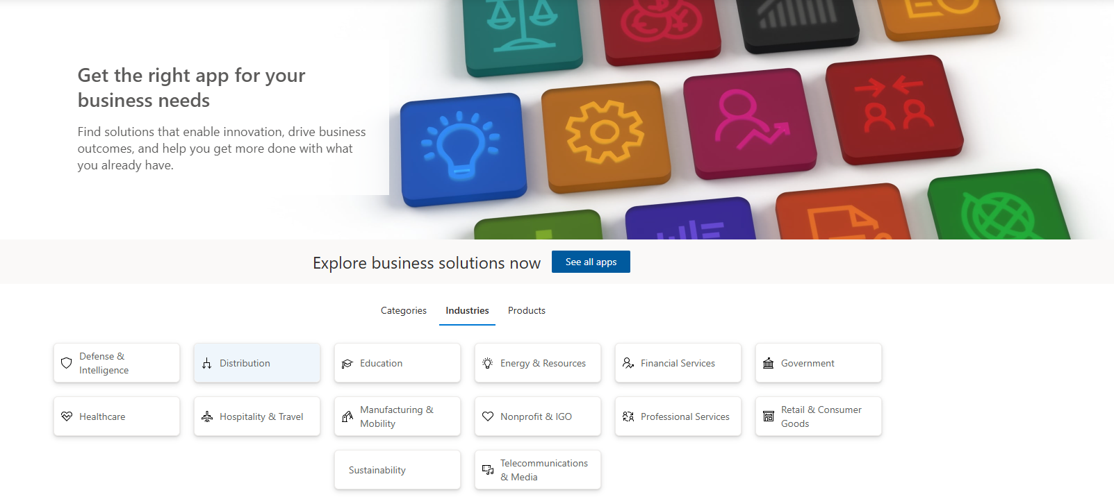
Business Central in AppSource – Point to point integrations

Slide 20
Real-life example

Slide 21
Change of website with minimal impact?
E-commerce client knew they had several legacy systems they had to replace within a year or two, but could not live without them or the integration to their new ERP. So they utilized the iPaaS or connection hub approach.
All integrations were built with standard API’s from ERP and website.
Connection hub made sure all systems were connected and sent data instantaneously without any custom-coding in either system.
Several API connections exchanged data such as Items, Prices, Invoices, Orders, Payment data, track and trace, etc. A lot of automation for a website.
After a year or so, the processes and integrations from the old website were changed to the new website with minimal impact.
Learnings: Standard API with connection HUB gave this client a minimal impact on their ERP processes.
Old Webshop
New webshop
IPaaS
Business Central

Slide 22
Key take-aways
Integrations minimize manual work and increase automation, but also increase complexity.
Consider the longevity of your systems before you decide on your integration approach.
Having an integration strategy minimizes your chance of errors. Talk to us about the option best suited for your business.

Slide 23
Q&A

Slide 24
AlfaPeople Ringager 4B - 2605 Brøndby Emil Møllers Gade 41B - 8700 Horsens Phone: +45 70 20 27 40 Email: info.dk@alfapeople.com www.alfapeople.com/dk

